Slide 1


Slide 2


Slide 3
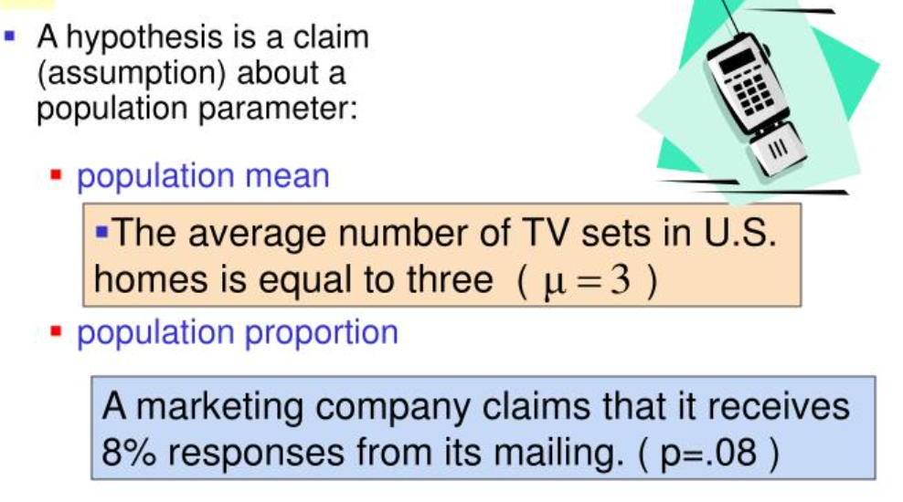

Slide 4
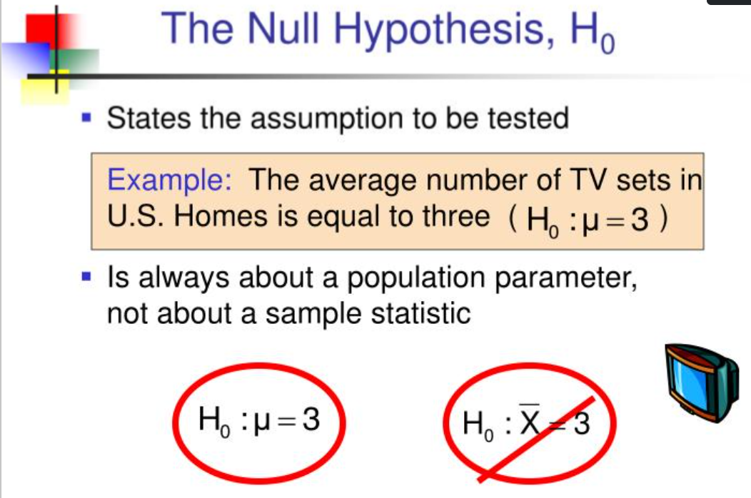

Slide 5
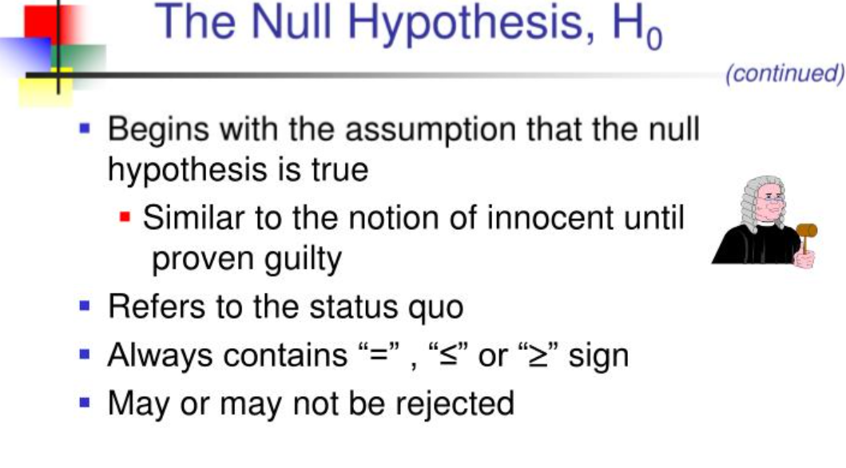

Slide 6
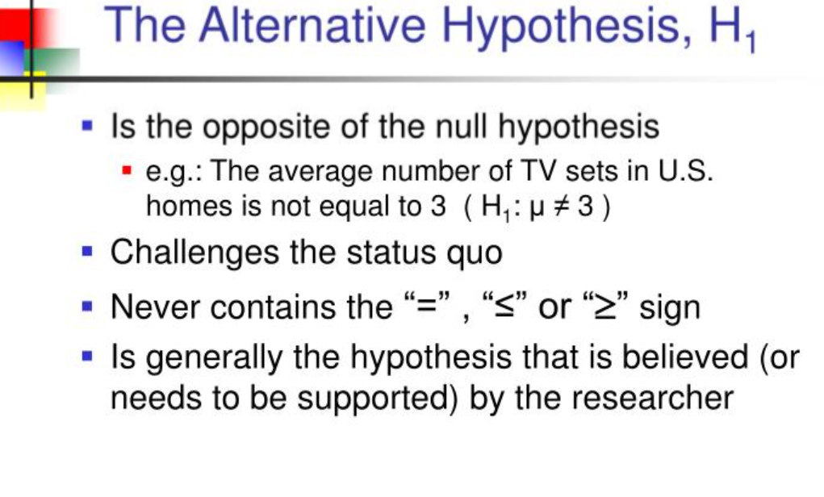

Slide 7
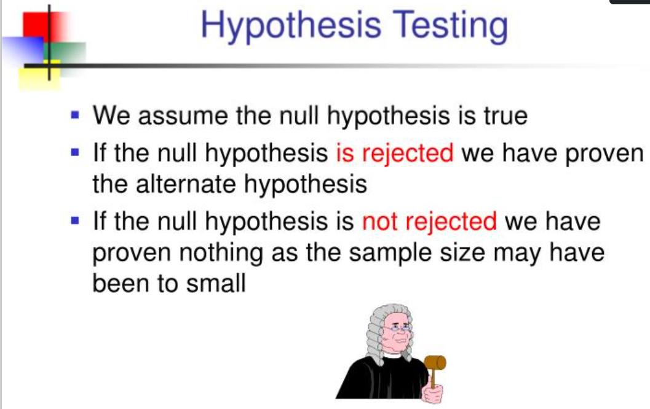

Slide 8
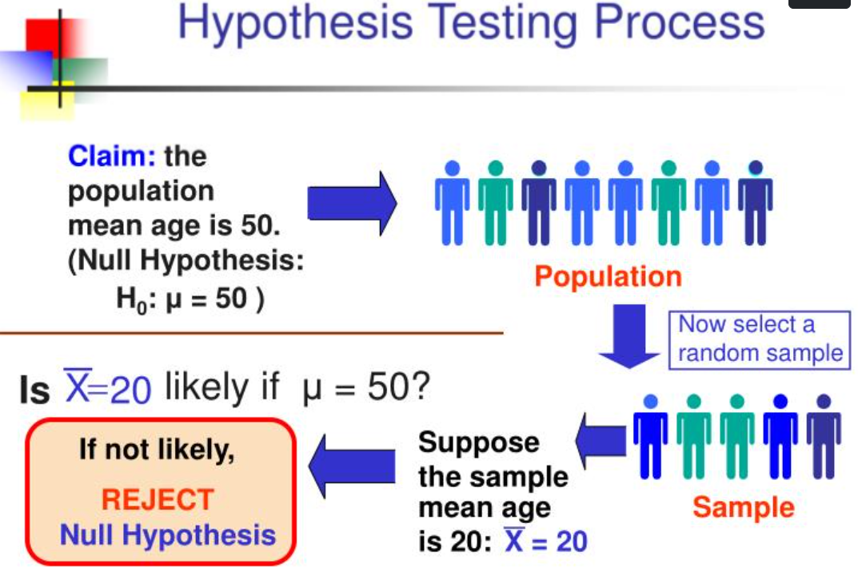

Slide 9
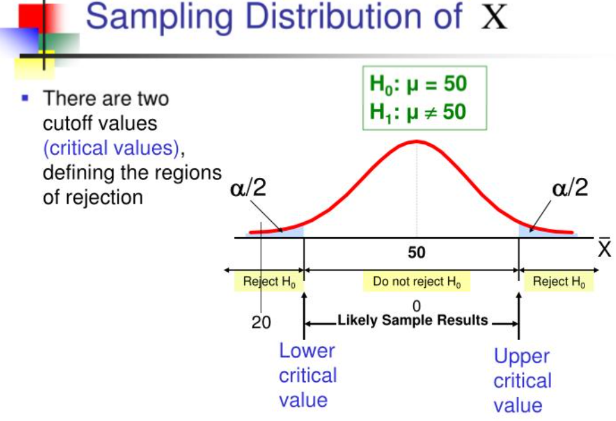

Slide 10
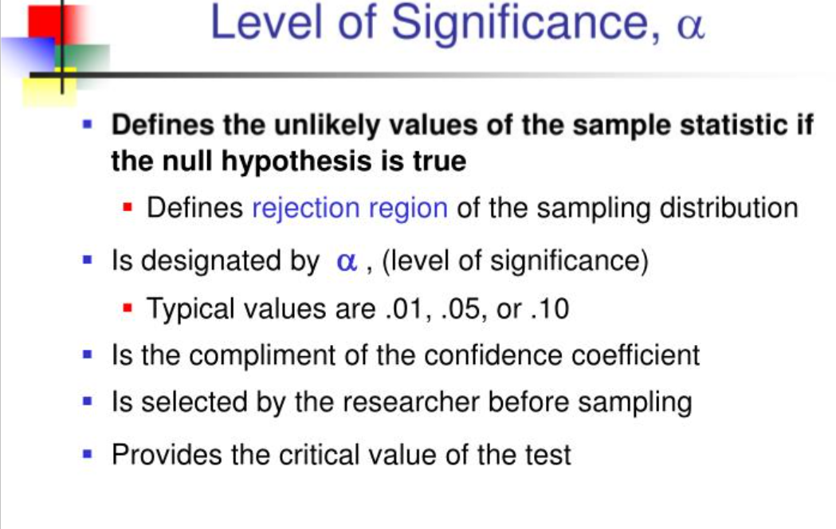

Slide 11
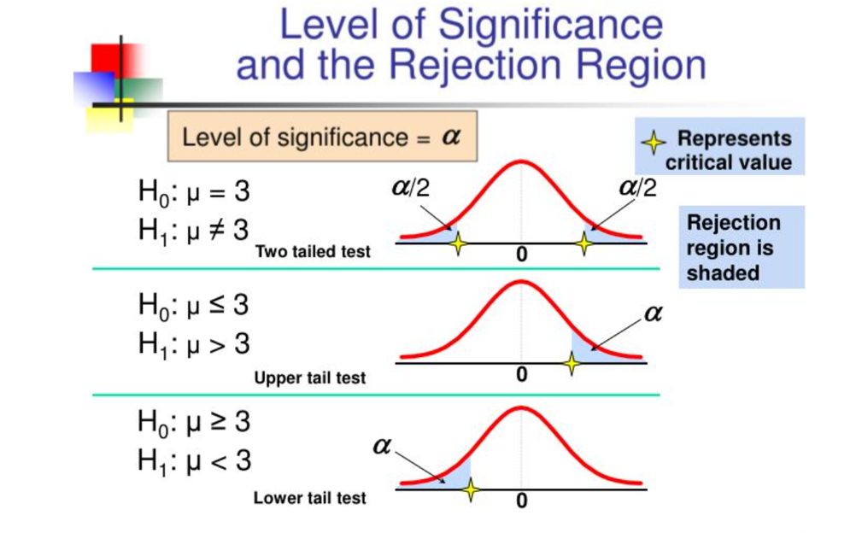

Slide 12
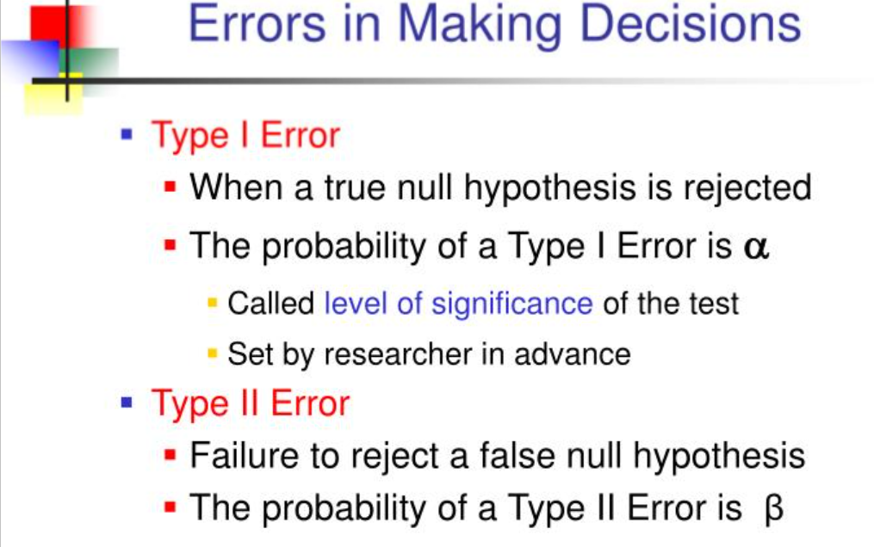

Slide 13
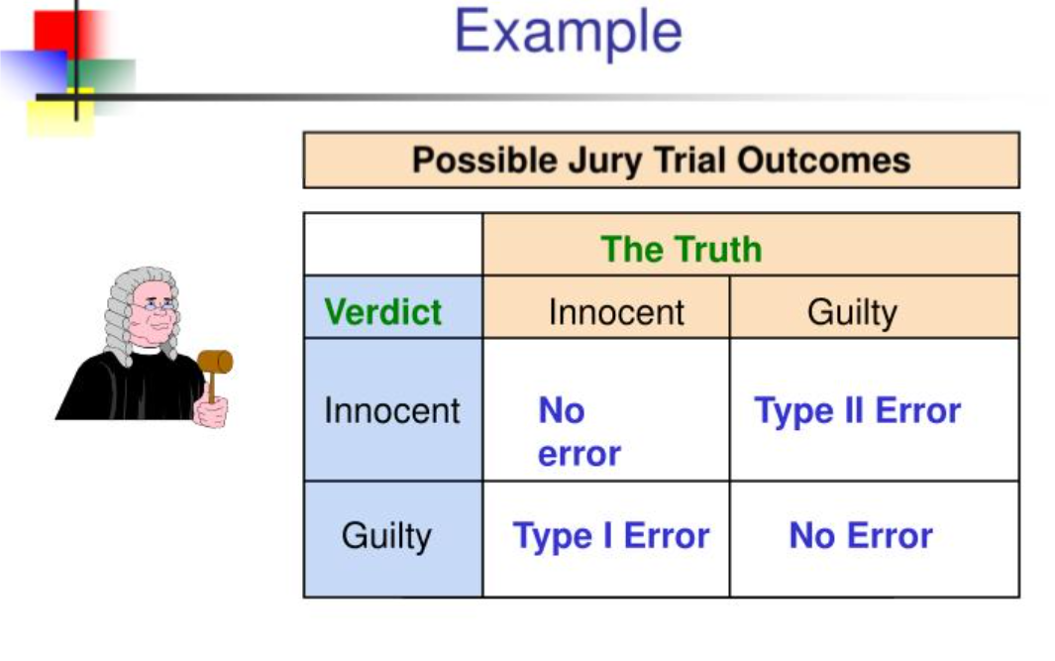

Slide 14
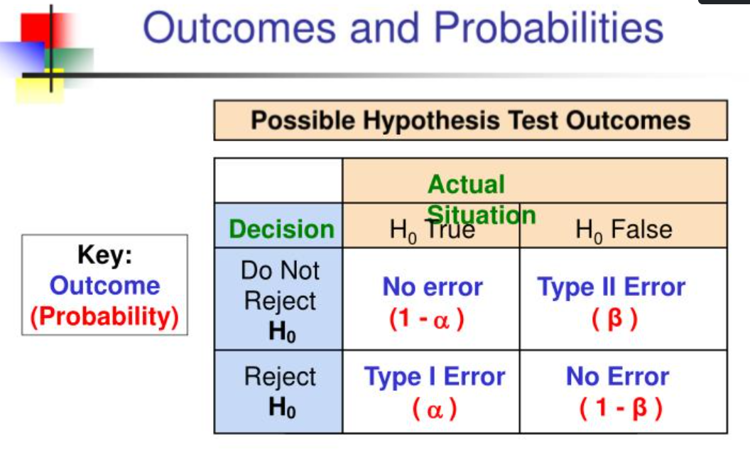

Slide 15
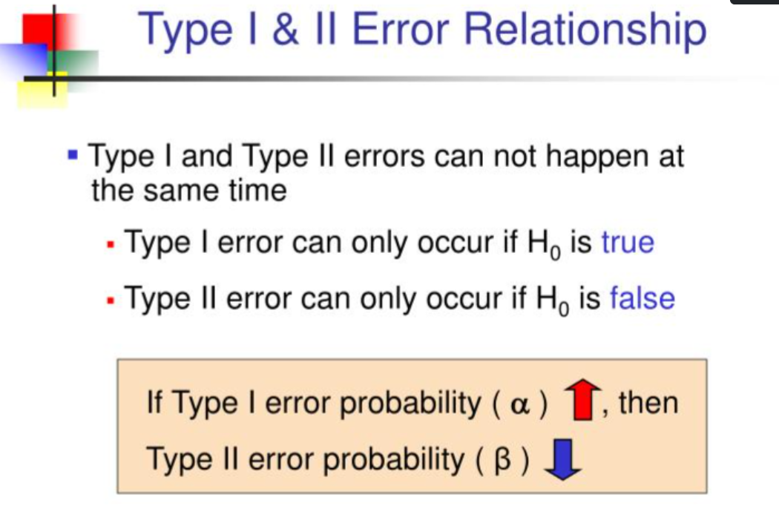

Slide 16
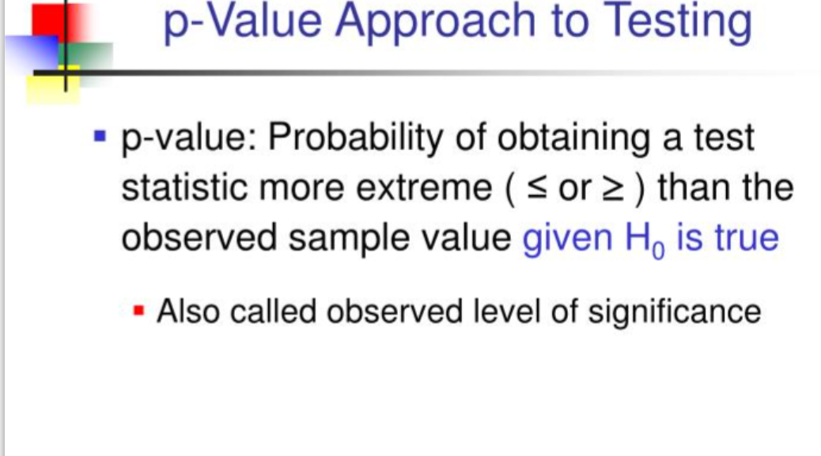

Slide 17
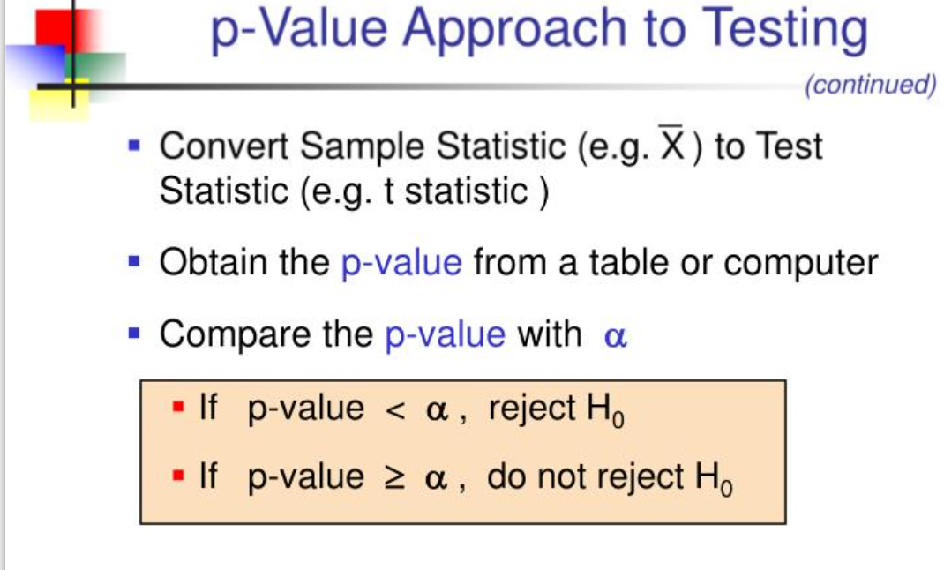

Slide 18
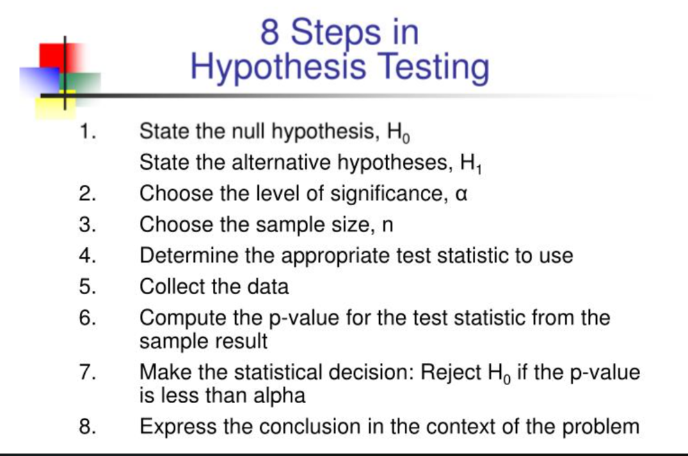

Slide 19
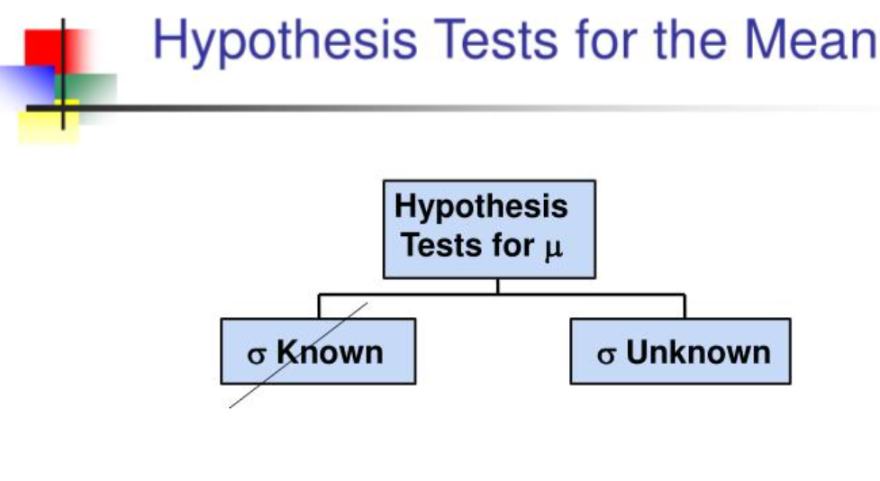
σ known

Slide 20
Level of Significance and the Rejection Region
Level of significance =
α
Represents
critical value
H₀: μ = 3 H₁: μ ≠ 3
α
α
/2
/2
Rejection region is shaded
Two-tail test
0
H₀: μ ≤ 3 H₁: μ > 3
α
Upper-tail test
0
H₀: μ ≥ 3 H₁: μ < 3
α
Lower-tail test
0

Slide 21

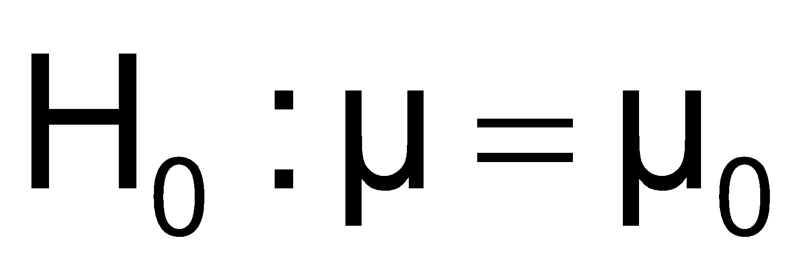
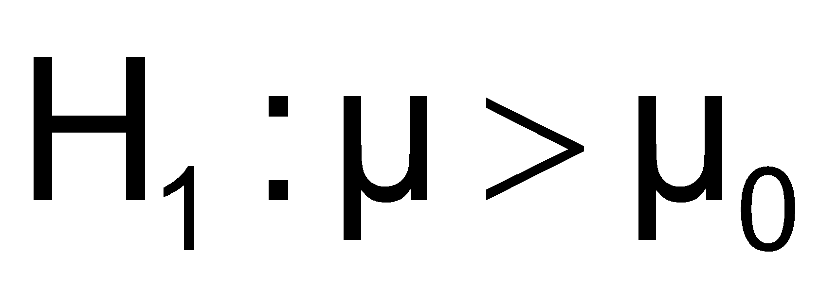
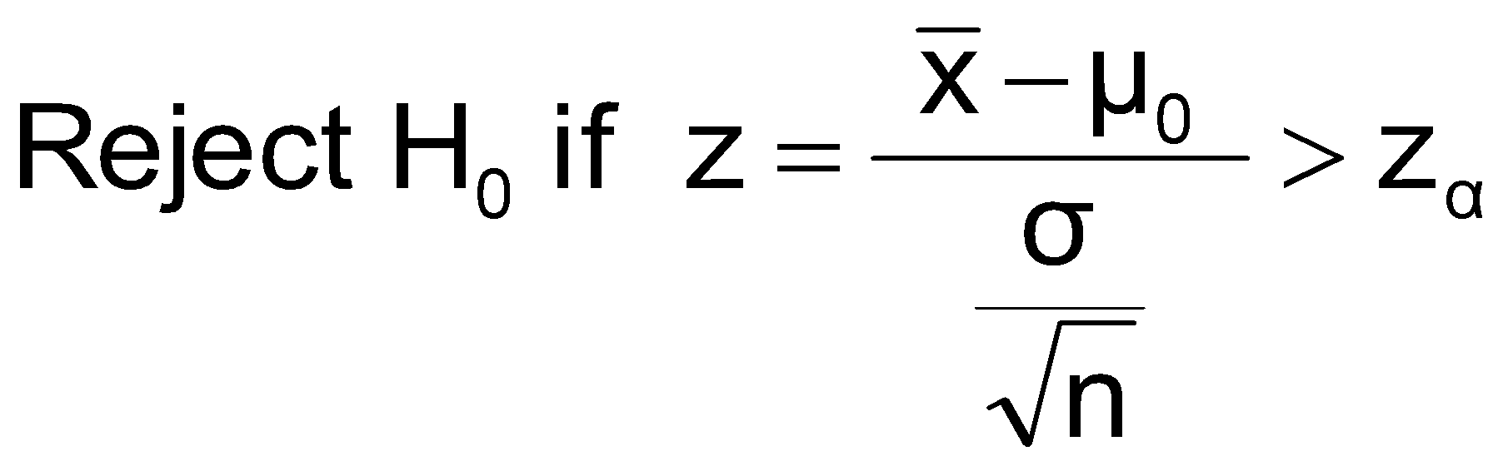
Test of Hypothesis for the Mean (σ Known)
Convert sample result ( ) to a z value
Hypothesis
Tests for μ
σ Known
σ Unknown
Consider the test
The decision rule is:
(Assume the population is normal)

Slide 22


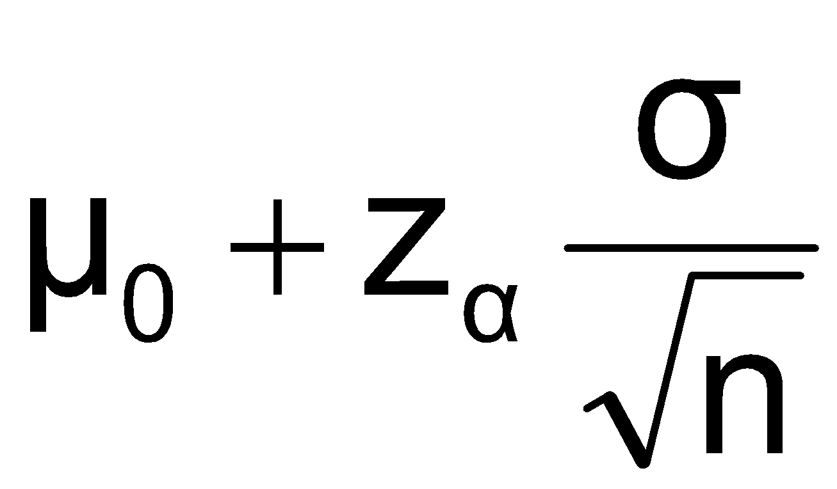
Decision Rule
H₀: μ = μ₀
H₁: μ > μ₀
Alternate rule:
α
Do not reject H₀
Reject H₀
Z
0
z_{α}
μ₀
Critical value

Slide 23
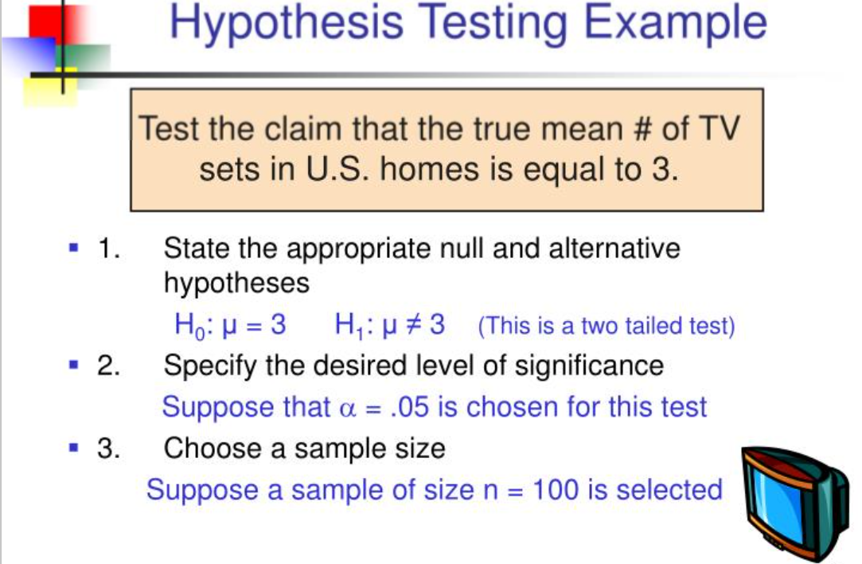

Slide 24
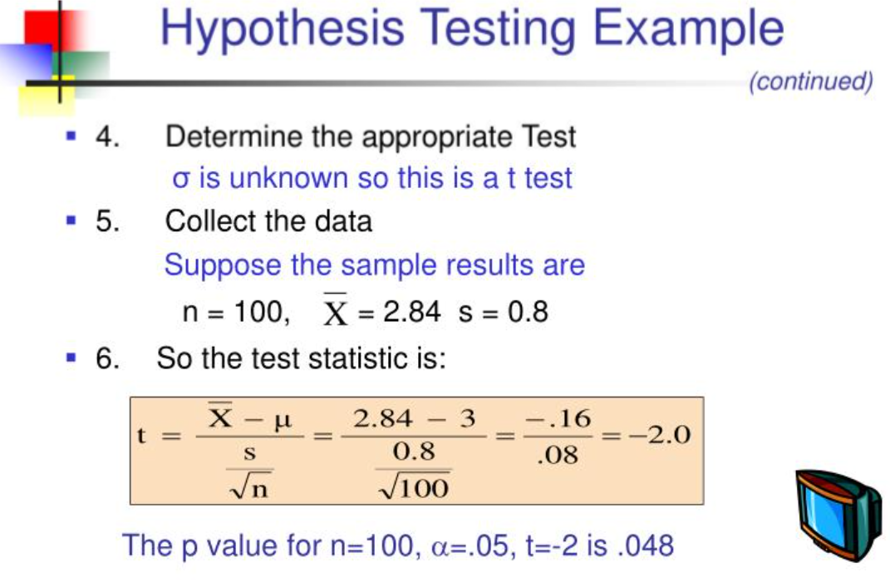

Slide 25
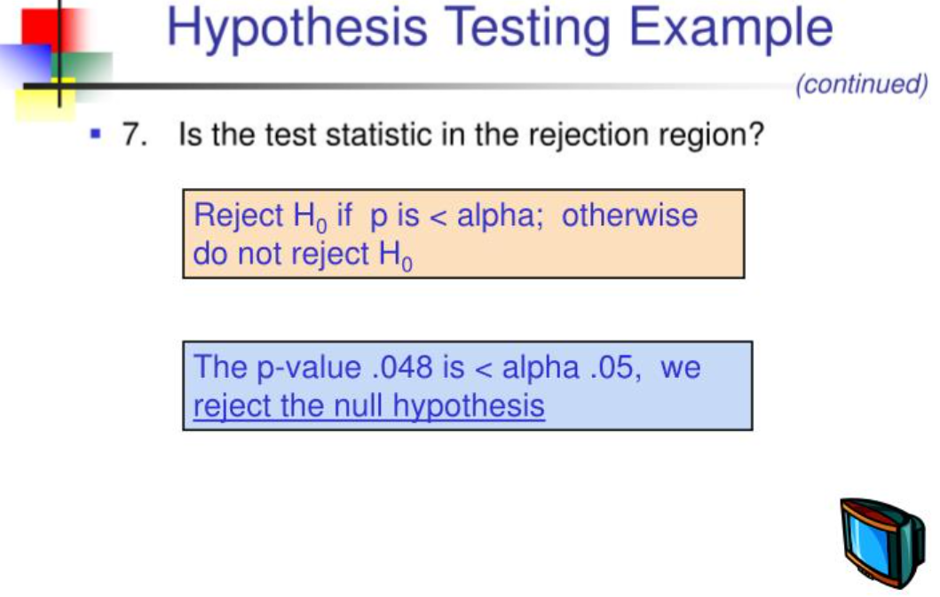

Slide 26
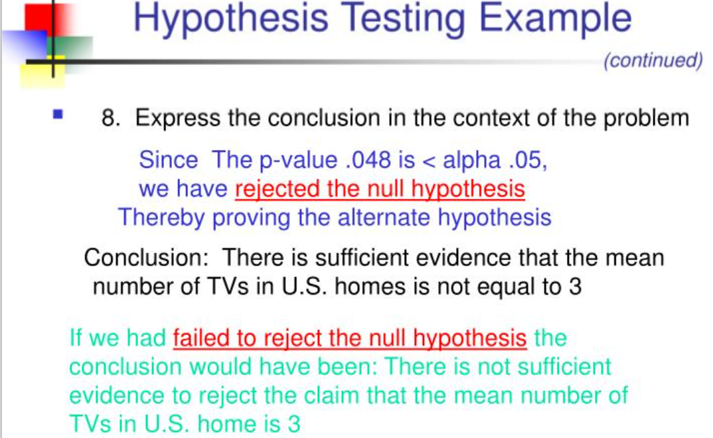

Slide 27
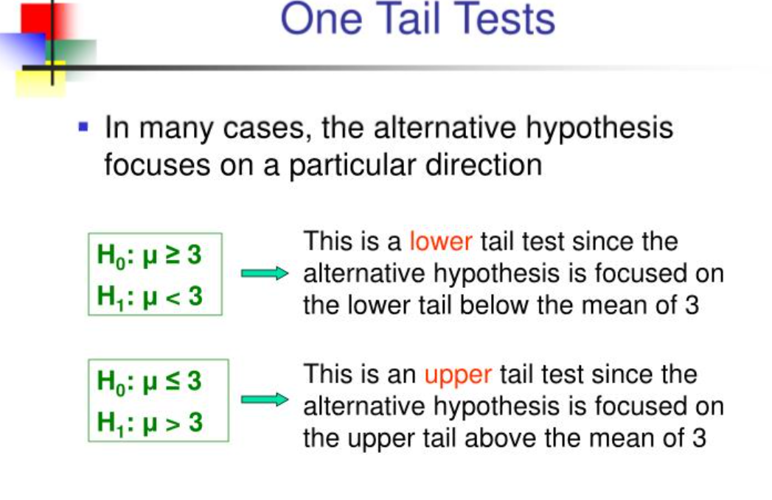

Slide 28
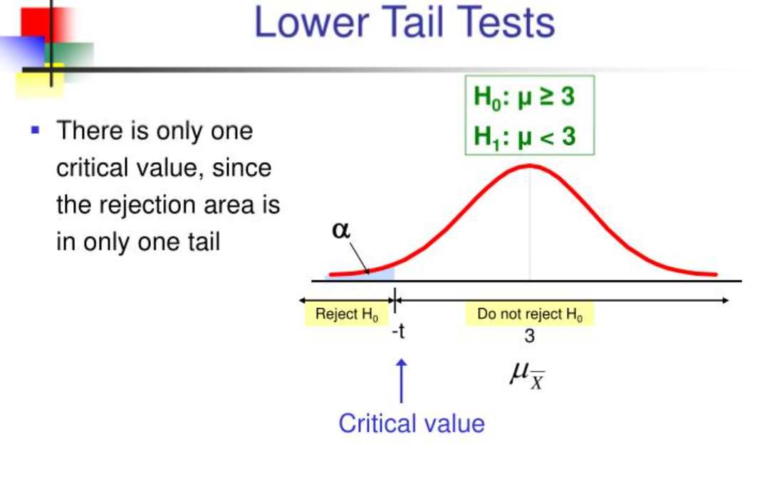

Slide 29
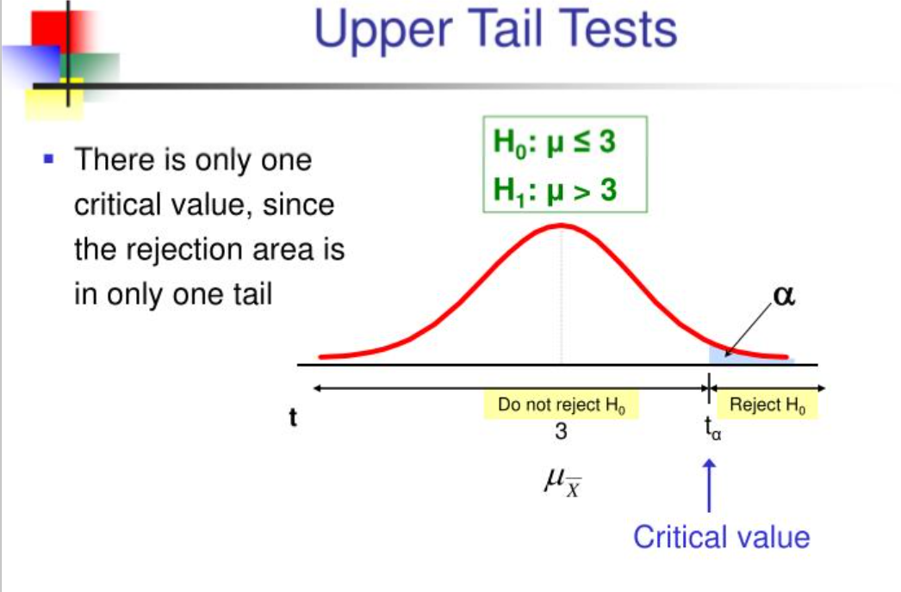

Slide 30
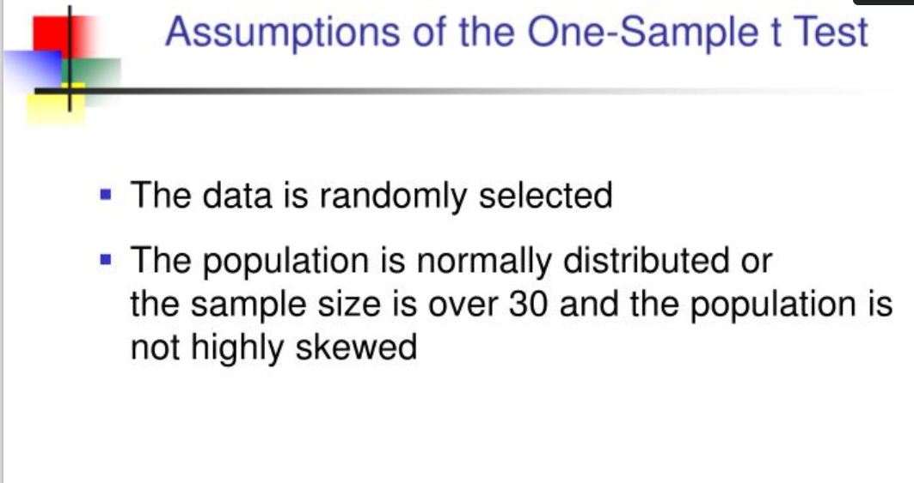

Slide 31
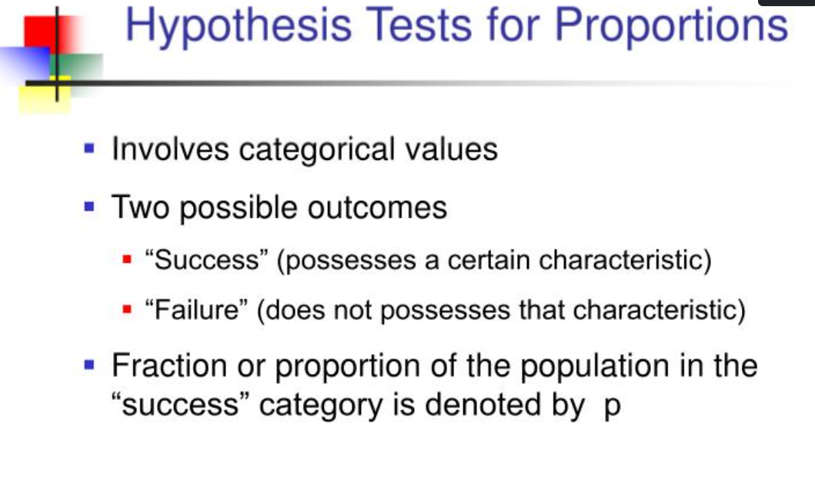

Slide 32
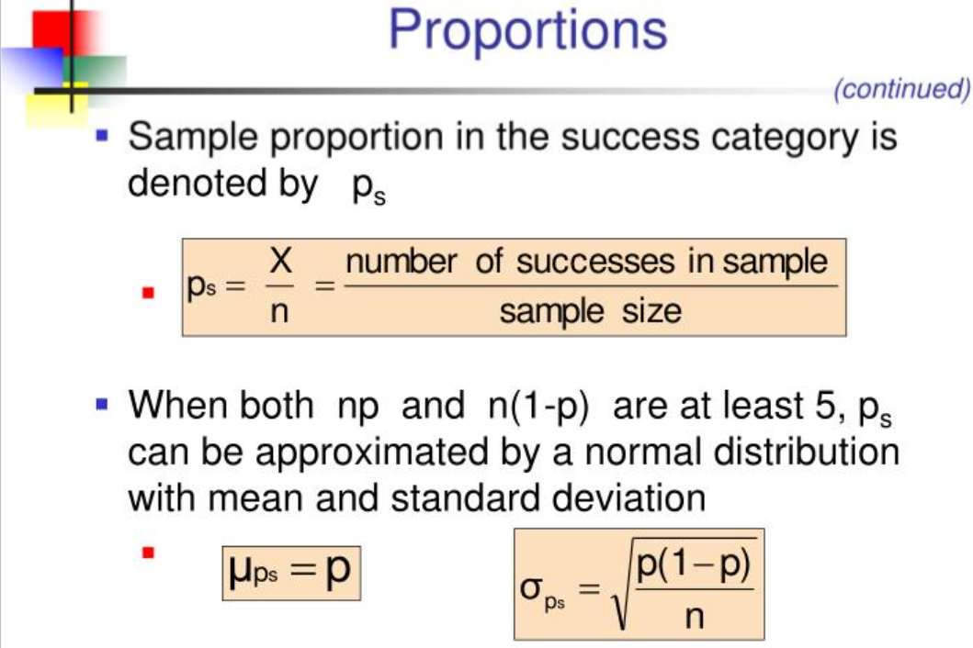

Slide 33
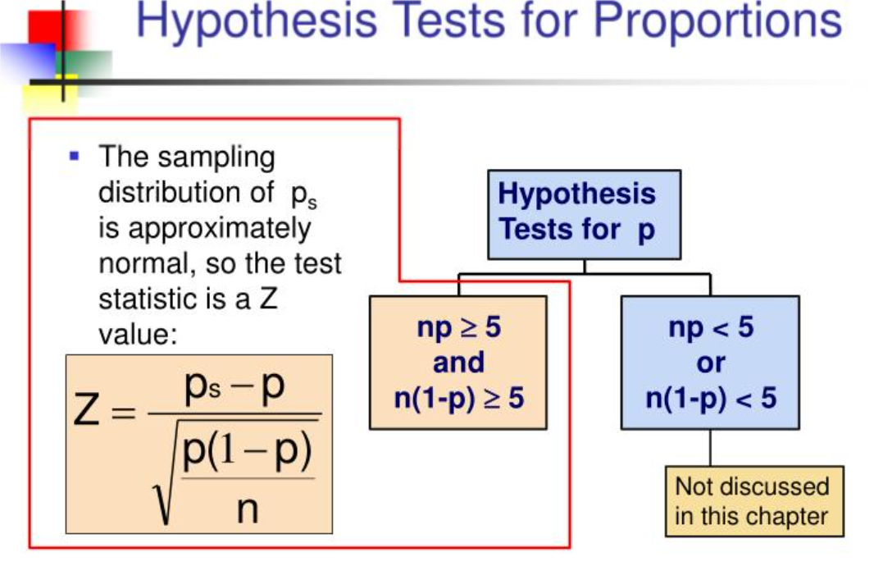

Slide 34
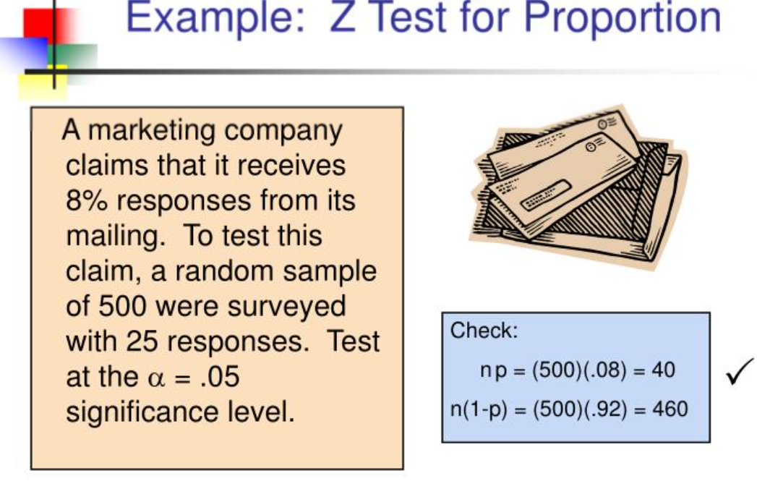

Slide 35
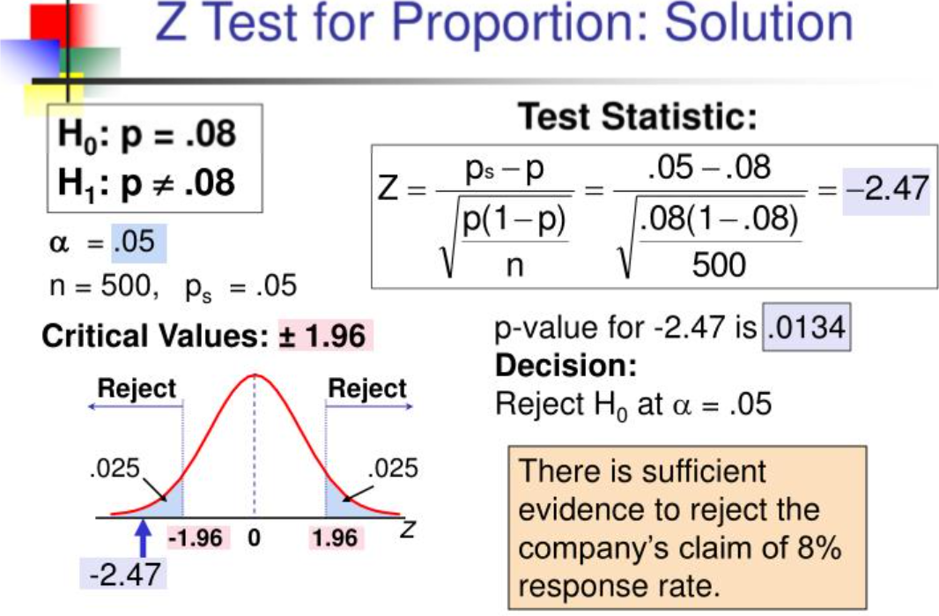

Slide 36
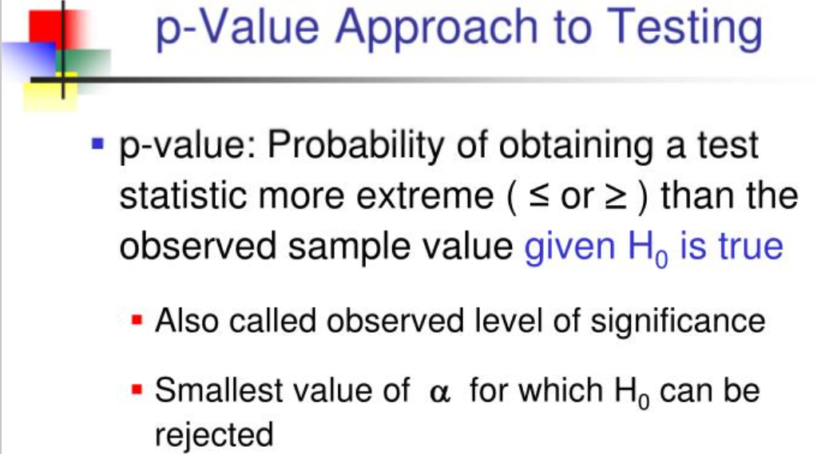

Slide 37
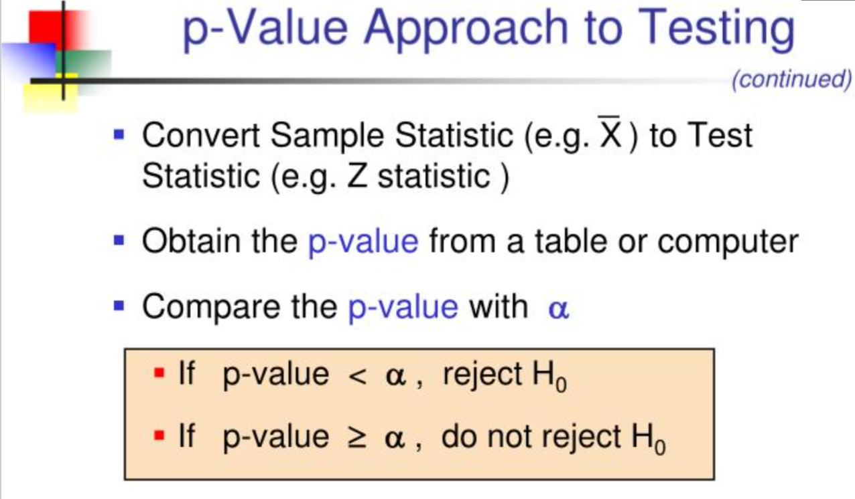

Slide 38
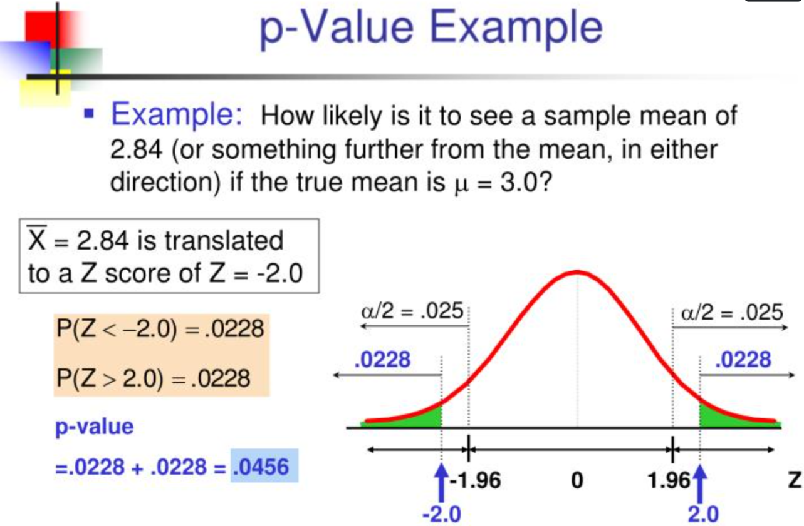

Slide 39
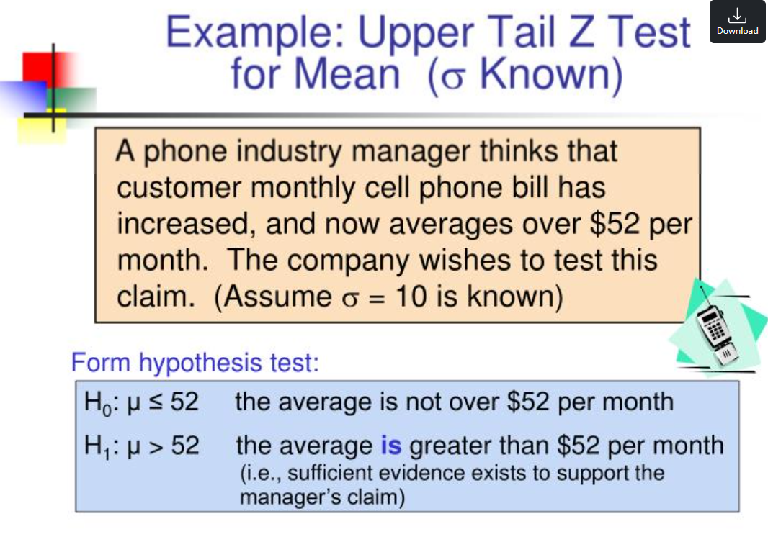

Slide 40
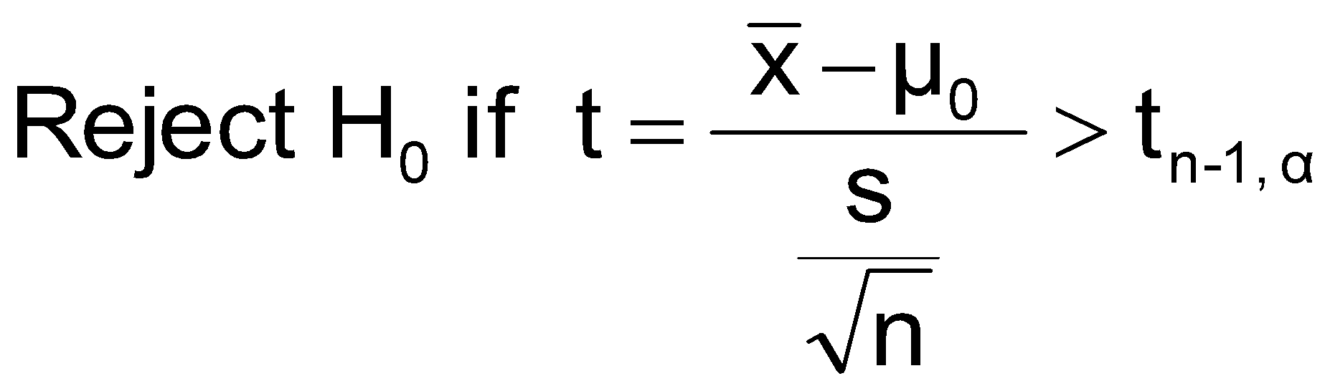
t Test of Hypothesis for the Mean (σ Unknown)
Convert sample result ( ) to a t test statistic
Hypothesis
Tests for μ
σ Known
σ Unknown
Consider the test
The decision rule is:
(Assume the population is normal)

Slide 41
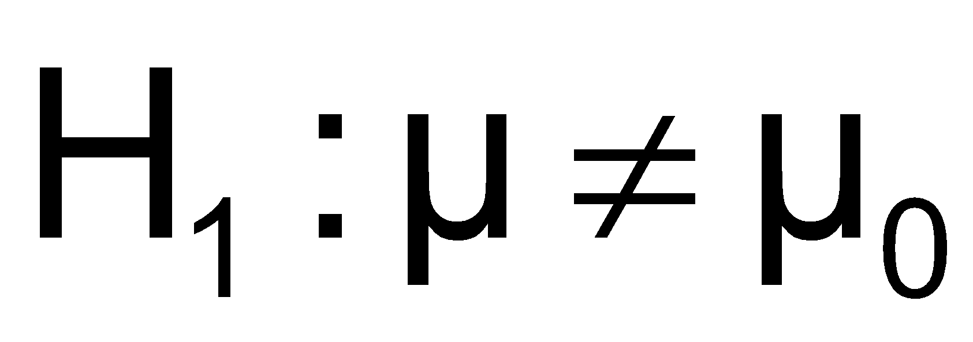
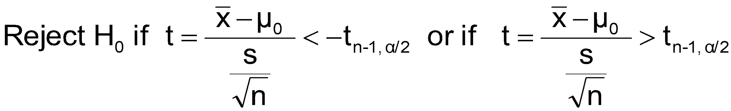
t Test of Hypothesis for the Mean (σ Unknown)
(continued)
For a two-tailed test:
Consider the test
(Assume the population is normal, and the population variance is unknown)
The decision rule is:

Slide 42
Tests of the Population Proportion
Involves categorical variables
Two possible outcomes
“Success” (a certain characteristic is present)
“Failure” (the characteristic is not present)
Fraction or proportion of the population in the “success” category is denoted by P
Assume sample size is large

Slide 43

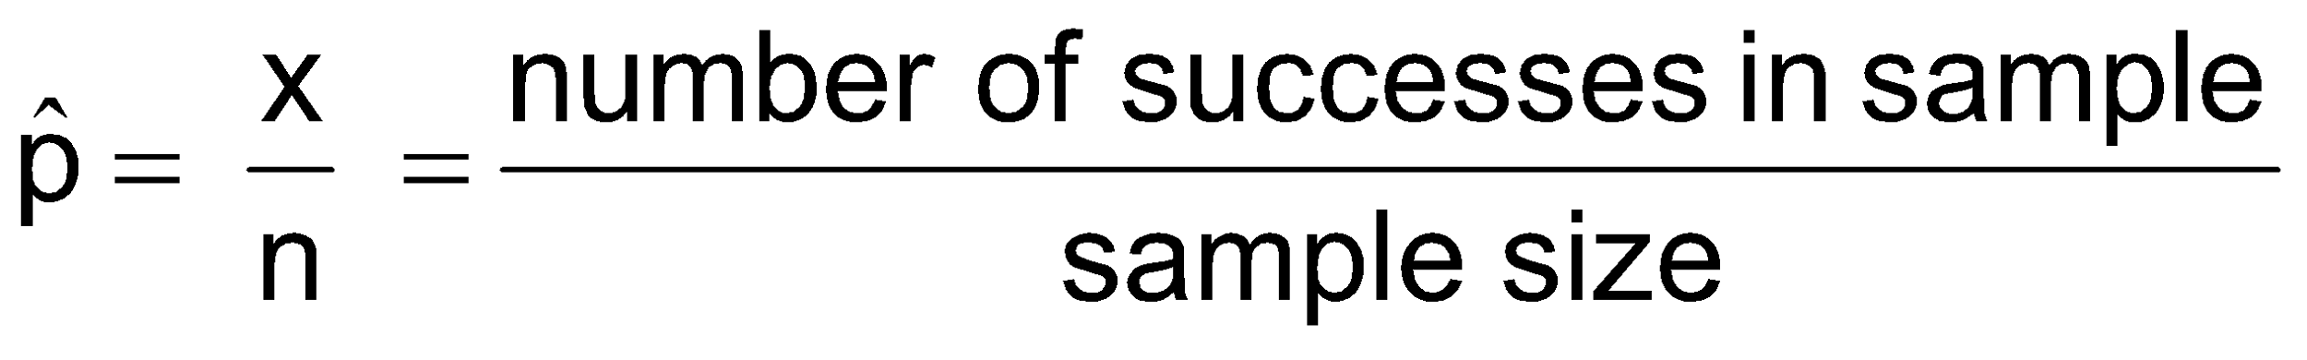

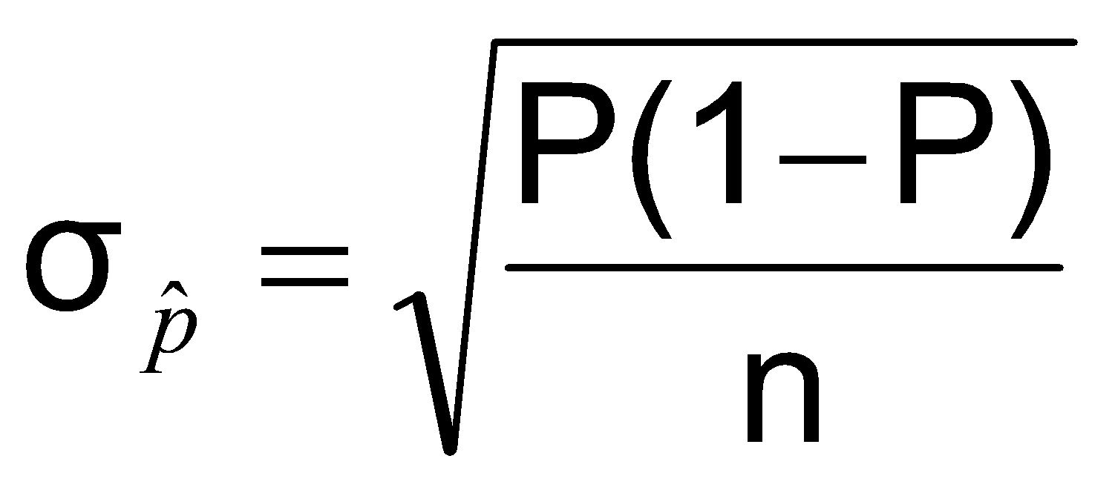
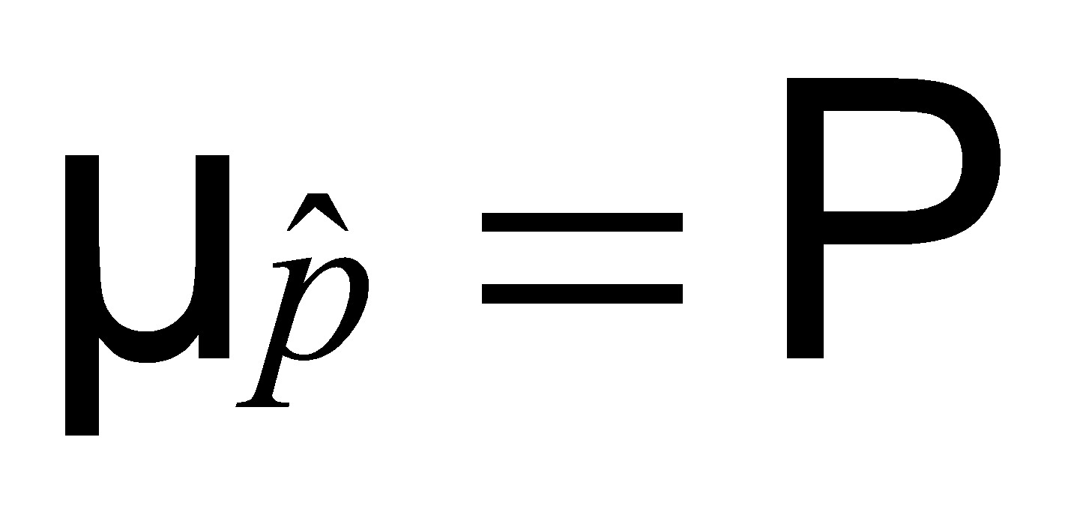
Proportions
(continued)
Sample proportion in the success category is denoted by
When nP(1 – P) > 9, can be approximated by a normal distribution with mean and standard deviation

Slide 44
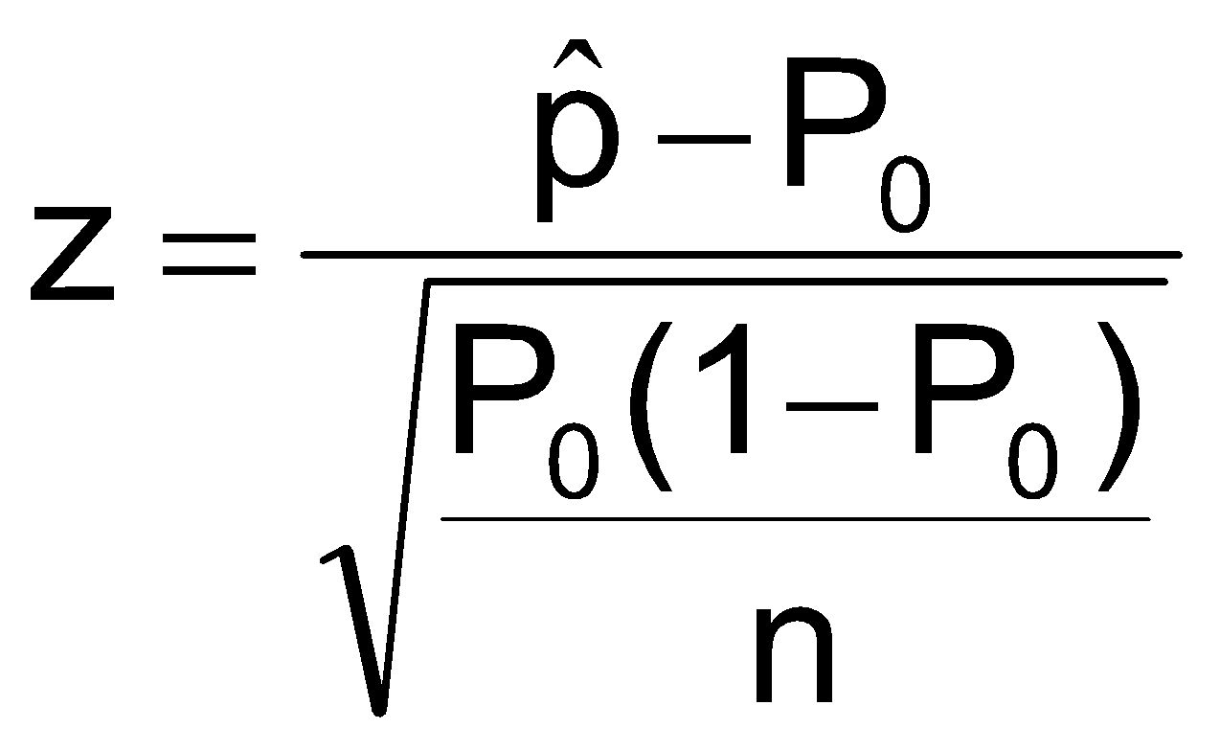
Hypothesis Tests for Proportions
The sampling distribution of is approximately normal, so the test statistic is a z value:
Hypothesis
Tests for P
nP(1 – P) > 9

Slide 45

Example: Two-Tail Test (σ Unknown)
The average cost of a hotel room in New York is said to be $168 per night. A random sample of 25 hotels resulted in x = $172.50 and
s = $15.40. Test at the
α = 0.05 level.
(Assume the population distribution is normal)
H₀: μ = 168 H₁: μ ≠ 168

